Slide 1
Exercise 3: sampling
See example Notebook: sampling
Load the class data csv file from the previous exercise
Choose a variable
Create 3 lists:
100 means of random samples (with replacement) of n=1 of your variable
100 means of random samples of n=5
100 means of random samples of n=10
Create density plots of each list. Do you see evidence of the central limit theorem?
Extra challenge: superimpose the density plots in one plot, with differing colors

Slide 2
Tips for graphs
Keep it simple, stupid (KISS)
Don’t use 3D
Don’t use pie charts (too often)
Give a title and label your axes

Slide 3

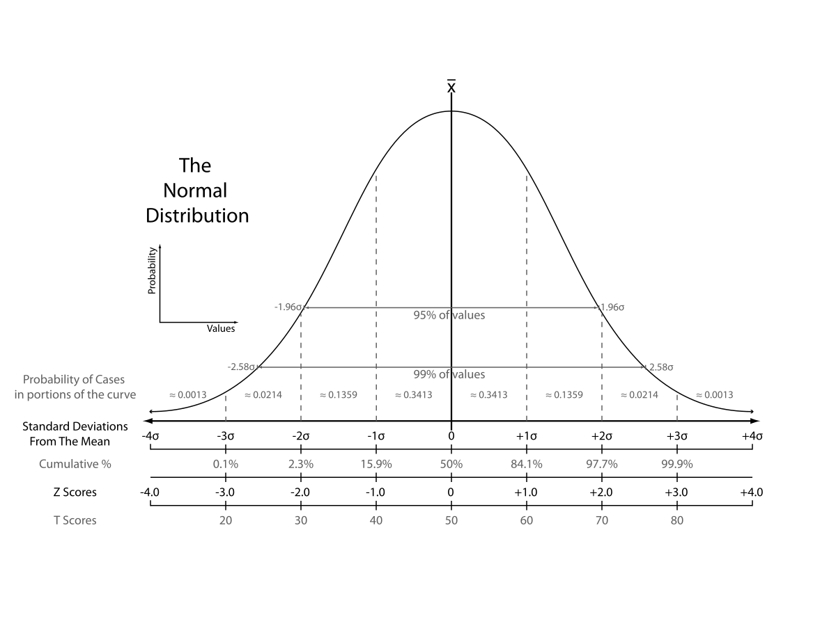
Normal distribution

Slide 4
Why is the normal distribution so important?
Some distributions in real life approach the ND
The ND is assumed in a lot of statistical modelling
Central limit theorem

Slide 5
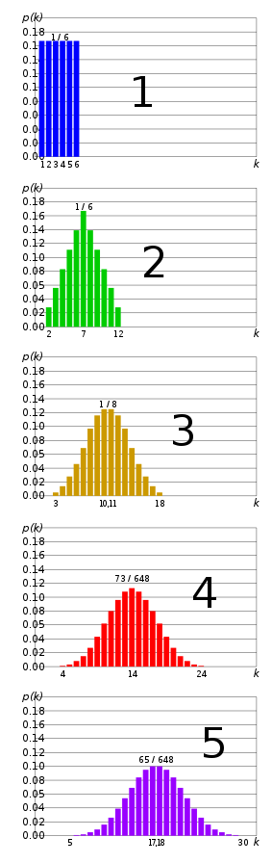
Central limit theorem
Sum of independent, identical distributions approaches normal distributions
See right: sum of 1…5 dice
Same goes for sampling distribution of the mean -> larger n, closer to normal

Slide 6
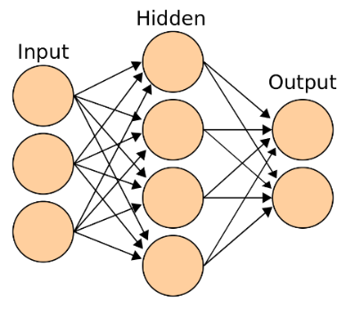
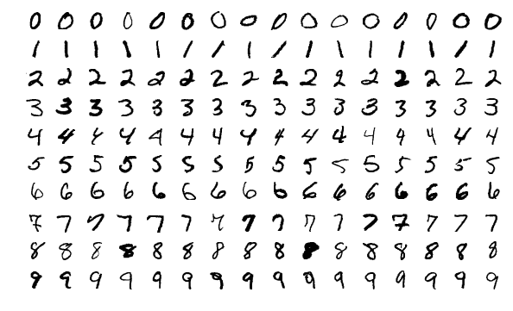
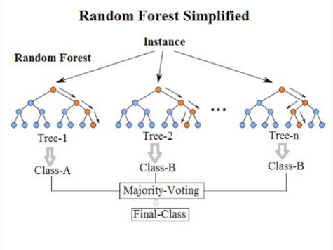

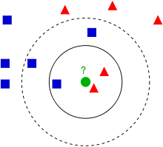

Example algorithms and applications
Algorithms
Applications
Neural network (deep learning)
playground
Random Forest
k-nearest neighbor

Slide 7
Common transformations
Data | Transformation
Multiple similar items on survey on happiness ‘I’m happy with the way things are going’ ‘I’m happy with my life’ | Sum or mean
Population Land area | Ratio (population/land area)
Date: 20-12-2010 | Numbers of days from start
Very right-skewed variables, e.g. YouTube views, income | ¹⁰Log(x) ¹⁰Log(10) = 1 ¹⁰Log(100) = 2 ¹⁰Log(1000) = 3

